Slide 1


Türkiye’s Public Administration Perspective Within The Framework Of Recent Practises
XXI. Central American and Caribbean Civil Service Forum
13-14 September 2022
Guatemala, Republic of Guatemala

Slide 2
OUTLINE
E-GOVERNMENT AND THE REDUCTION OF ADMINISTRATION BURDEN
  Digital Türkiye
  Digital Public Administration
    Specific Political Communications (Development Plan, Annual Programme)
OUTPUTS OF NEW PUBLIC ADMINISTRATION APPROACH
  Some Practises In The Recruitment System
  The Electronic Public Information Management System
  Distance Learning Gate
  Career Gate
  Training Needs Analysis
  Training and Development Activities Report
  Flexible Working
  Education Information Network

Slide 3
E-GOVERNMENT AND
THE REDUCTION OF ADMINISTRATION BURDEN
Digital Türkiye
e-Governmet Gateway is a system which was accessed in 2008. In order to increase the capacity of technological infrastructure Digital Türkiye project which is fast and secure access to public service from a single point was launched in 2016.
As of September 1, 2022 the Digital Türkiye Platform has reached above 60 million users and currently there are services provided by 890 institutions available on the Digital Türkiye Platform (e-Governmet Gateway)

Slide 4
E-GOVERNMENT AND
THE REDUCTION OF ADMINISTRATION BURDEN
Digital Türkiye
Our goal of Digital Türkiye is to increase the number of high value-added services and make them available for everyone. We also plan to prepare user-friendly interfaces and allow people to use Digital Türkiye with a greater level of comfort.

Slide 5
E-GOVERNMENT AND
THE REDUCTION OF ADMINISTRATION BURDEN
Digital Türkiye
Digital Türkiye Version 1.0 (v1.0);
digitalized high value-added services,
reduced the number of documents, (the document required for job application can be sent electronically)
brought savings from time and money, (It is stated that the validity of the documents are official with the reference number, so that there is no need to go another authority to proof of it)
reduced bureaucracy.

Slide 6
E-GOVERNMENT AND
THE REDUCTION OF ADMINISTRATION BURDEN
Digital Türkiye
We launch the process of integrated service provision with Digital Türkiye version 1.1 which is currently in the pipeline. In this aspect, such topic-based integrated services focusing on user as ‘My Vehicles’, ‘My Working Life’ and facilitate the lives of our citizens.

Slide 7
E-GOVERNMENT AND
THE REDUCTION OF ADMINISTRATION BURDEN
Digital Türkiye
From e-Government Gateway, as of September 1, 2022;
Number of Registered Users of e-Government Gateway: 60.3 Million
Number of Services Provided via e-Government Gateway (Cumulative): 6.720

Slide 8
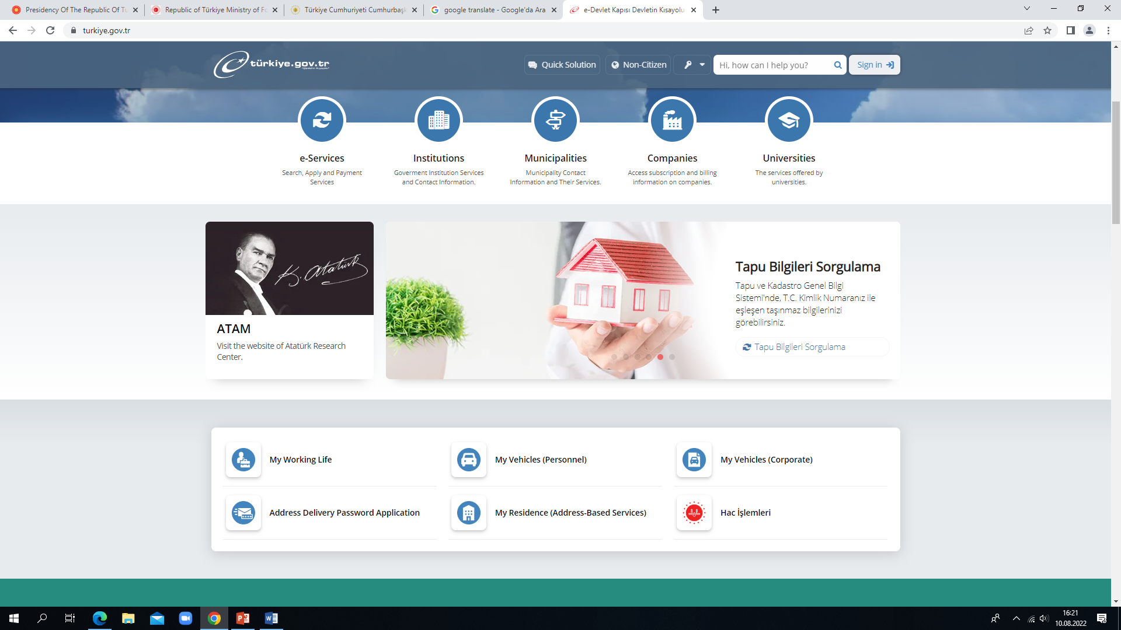

Slide 9
Targets Table*
*This information has been compiled from the https://cbddo.gov.tr/ and the annual programme
**Individulas between the ages of 16-74
***Realization forecast
E-GOVERNMENT AND
THE REDUCTION OF ADMINISTRATION BURDEN
Digital Türkiye
Performance Indicators | Unit | 2020 | 2021 | 2022***
Individuals Using e-Government Gateway* | Percent | 51,2 | 58,9 | 60
e-Government Gateway Satisfaction Rate | Percent | 98,3 | 99 | 99
Number of e-Government Gateway Registered Users | Million People | 52 | 57 | 60

Slide 10
DIGITAL PUBLIC ADMINISTRATION
Specific Political Communications
(Eleventh Development Plan)
On 18 July 2019, The Eleventh Development Plan (2019-2023) was approved by the Grand National Assembly of Türkiye.
Being the first Plan prepared after the adoption of the new Presidential Government System, the Plan was shaped with a long-term perspective to constitute the main roadmap for improving the international position of the country and the welfare of the society.

Slide 11
DIGITAL PUBLIC ADMINISTRATION
Specific Political Communications
(Eleventh Development Plan)
This Plan is a holistic and multi-dimensional national policy document covering the following development axes: sustainable environment and livable cities; qualified people and strong society; rule of law, democratization and good governance; competitive production and productivity; and stable and strong economy. e-Government related policies are explained in the section of the Plan titled ‘e-Government Applications in Government Services’.

Slide 12
DIGITAL PUBLIC ADMINISTRATION
Specific Political Communications
(Eleventh Development Plan)
This Plan aims to digitalize Turkish public services by process modernization and improvement. The digitalization of public services will ensure effectiveness while pursuing a user oriented perspective based on an increased service delivery and usage.
This Plan also aims to achieve a 95% satisfaction rate for e-Government services by 2023, while raising the uptake of electronic services to 70% with further services integrated in the e-Government Gateway.

Slide 13
DIGITAL PUBLIC ADMINISTRATION
Specific Political Communications
(Eleventh Development Plan)
  The main actions of the Plan regarding e-Government are:
  e-Government efforts will be carried out aiming at a user-oriented service delivery and an effective public administration. The needs of disadvantaged groups will be prioritised. (There are different channels of services for Disabled people)
  new technologies and trends will be used when providing e-Government services to increase the efficiency, effectiveness, transparency and accountability of the public sector.
  the governance and coordination structure regarding e-Government activities will be strengthened.

Slide 14
DIGITAL PUBLIC ADMINISTRATION
Specific Political Communications
(Presidential Annual Programme)
Following the Presidential Annual Programme, the Turkish government;
brought forward several e-Government activities with the objective of increasing the effectiveness of the public administration and the variety of services provided and prioritizing the needs of the disadvantaged people.

Slide 15
DIGITAL PUBLIC ADMINISTRATION
Specific Political Communications
(Presidential Annual Programme)
Following the Presidential Annual Programme, the Turkish government;
continued to develop the basic information systems necessary to provide e-Government services. Additionally, the government aims to setup a joint infrastructure to ensure that these information systems operate in a sustainable manner.

Slide 16
OUTPUTS OF NEW PUBLIC ADMINISTRATION APPROACH
Some Practises In The Recruitment System
In our recruitment system, generally, central exam is applied to become a public official. This exam is used as a pre-application requirement for employment.
In this system, there is a language requirement for some positions. In order to meet this requirement quickly, electronic foreign language exams are held regularly throughout the year.
Also, in this system, a seperate exam is held for disabled civil servants in accordance with their disabilities.

Slide 17
OUTPUTS OF NEW PUBLIC ADMINISTRATION APPROACH
The Electronic Public Information Management System
The Electronic Public Information Management System (KAYSİS) is an information management system which carries out a range of functions regarding the definition of various elements in public administration, such as the organizational structure of public institutions and organizations, their services, the documents used in the services and the contact and management information of institutions. https://www.kaysis.gov.tr/

Slide 18
OUTPUTS OF NEW PUBLIC ADMINISTRATION APPROACH
The Electronic Public Information Management System
The system also defines their legal bases and describes them digitally. It will also enable the integration of new Digital Türkiye (e-government) applications with each other from a central point.

Slide 19
OUTPUTS OF NEW PUBLIC ADMINISTRATION APPROACH
Distance Learning Gate
Distance Learning Gate is a national learning platform that is put into service of institutions to equip public employees with appropriate knowledge, skills, and competencies. The platform, designed within the scope of Digital Türkiye Project, is aimed to provide equal opportunity in employee training, increase human resource efficiency, and the quality of training and development activities.
With the Distance Learning Gate, public institutions can arrange all training activities which they prepare for their employees, such as occupational and personal development.
https://www.cbiko.gov.tr/en/projects/distance-learning-gate

Slide 20
OUTPUTS OF NEW PUBLIC ADMINISTRATION APPROACH
Career Gate
Career Gate, integrated with e-Government, is a digital platform in order to share public institutions’ career and internship opportunities with the public more effectively and ensuring merit-based equality of opportunity in public employment.
Candidates will be able to apply job postings of all public institutions on the Career Gate Platform. Additionally, within the scope of the Internship Mobilization Program, students can benefit from internship opportunities of all public institutions and voluntary employers from the private sector through the Career Gate. https://www.cbiko.gov.tr/en/projects/career-gate

Slide 21
OUTPUTS OF NEW PUBLIC ADMINISTRATION APPROACH
Training Needs Analysis
It is a systematic analysis used to determine the necessary training for the personal and professional development needs of employees in line with the mission, vision and goals of public institutions.
It is conducted to indicate the training needs of all public employees.
It consists of Ministry-specific duties and responsibilities, competencies, legislation, computer applications, and systems, and is based on six title groups: top manager, manager, administrative, technical, profession, and service title group.

Slide 22
OUTPUTS OF NEW PUBLIC ADMINISTRATION APPROACH
Training and Development Activities Report
The Public Institutions Training and Development Activities Report is prepared in order to offer data-based solutions for the personnel training and development activities of the Ministries, to identify the strength or improvement areas for the implications, and to disseminate good practices by evaluating the training and development activities of the Ministries.

Slide 23
OUTPUTS OF NEW PUBLIC ADMINISTRATION APPROACH
Training and Development Activities Report
Within the report, the data on the training and development activities are analyzed by using appropriate scientific methods in the details of employee and training records of public institutions, training budget and number participation in training. In addition, national and international training implications are also included in the report.

Slide 24
OUTPUTS OF NEW PUBLIC ADMINISTRATION APPROACH
Flexible Working
Flexible working was implemented in some institutions before Covid 19 and this practise still continues for certain institutions
It was applied to all employees in the public sector during early stage of Covid 19
Remote working was used as a flexible working model in public sector.
Employees thought to be more affected by the Covid 19 were also considered on leave

Slide 25
OUTPUTS OF NEW PUBLIC ADMINISTRATION APPROACH
Education Information Network
Education Information Network is a social educational content network established by the Ministry of National Education
This system which draws atteniton with its rich content specific to each class has been prepared to support students lessons
This system also has enabled teachers to carry out their duties effectively during the pandemic
In addition, during the pandemic, additional internet use was provided to the students by the operators with the encouregment of the government https://www.eba.gov.tr/

Slide 26
Thanks for your attention!

Slide 27
Türkiye’s
Governmet System
XXI. Central American and Caribbean Civil Service Forum
13-14 September 2022
Guatemala, Republic of Guatemala

Slide 28
OUTLINE
Turkish Constitutional Reform in 2017
Türkiye’s Presidential System

Slide 29
GOVERNMENT SYSTEM
Turkish Constitutional Reform in 2017
Following the constitutional amendment in Türkiye with the referendum on April 16, 2017, the existing structure operating on the basis of the parliamentary regime came to an end and a new government system called the Presidential Government System was introduced.

Slide 30
GOVERNMENT SYSTEM
Turkish Constitutional Reform in 2017
  Constitutional Reform has three basic institutional features:
  The first of these is the acknowledgment of the supremacy of the legislature. (Laws are higher norm than presidential decrees)
  The second is the targeting of an effective executive structure aimed at rapid decision making and implementation. (Changing the organizational structure of instutitions in accordance with needs is done quickly)
  The last one is that various mechanisms are included in order to ensure the functionality of the system to prevent it from being locked in possible times of crisis. (Confidence vote is not necessary to establish a government)

Slide 31
GOVERNMENT SYSTEM
Türkiye’s Presidential System
There is a clear distinction between legislative and executive powers.
The President who is the head of the executive power and parliament are directly elected by the nation. Therefore, both powers have the same legitimacy.
In the presidential government system, where the principle of separation of powers is clearly applied, powers do not have to take the vote of confidence.

Slide 32
GOVERNMENT SYSTEM
Türkiye’s Presidential System
Due to the clear distinction between legislative and executive powers, the executive has no authority to propose laws but budget law’s proposal.
Laws are enacted bye parliament and approved by the president. Laws returned to parliament for re-negotiation must be adopted by simple majority.
The executive power cannot terminate the legislative power. However, any of the powers may wish to renew the elections.

Slide 33
GOVERNMENT SYSTEM
Türkiye’s Presidential System
Ministers are appointed and dismissed by the presi­dent.
Parliament is no longer required to confirm the government. It can no longer hold confidence votes, nor dismiss the government on political grounds.
Parliamentary questions are ad­dressed to the deputy president and the ministers. These questions are answered in writing.

Slide 34
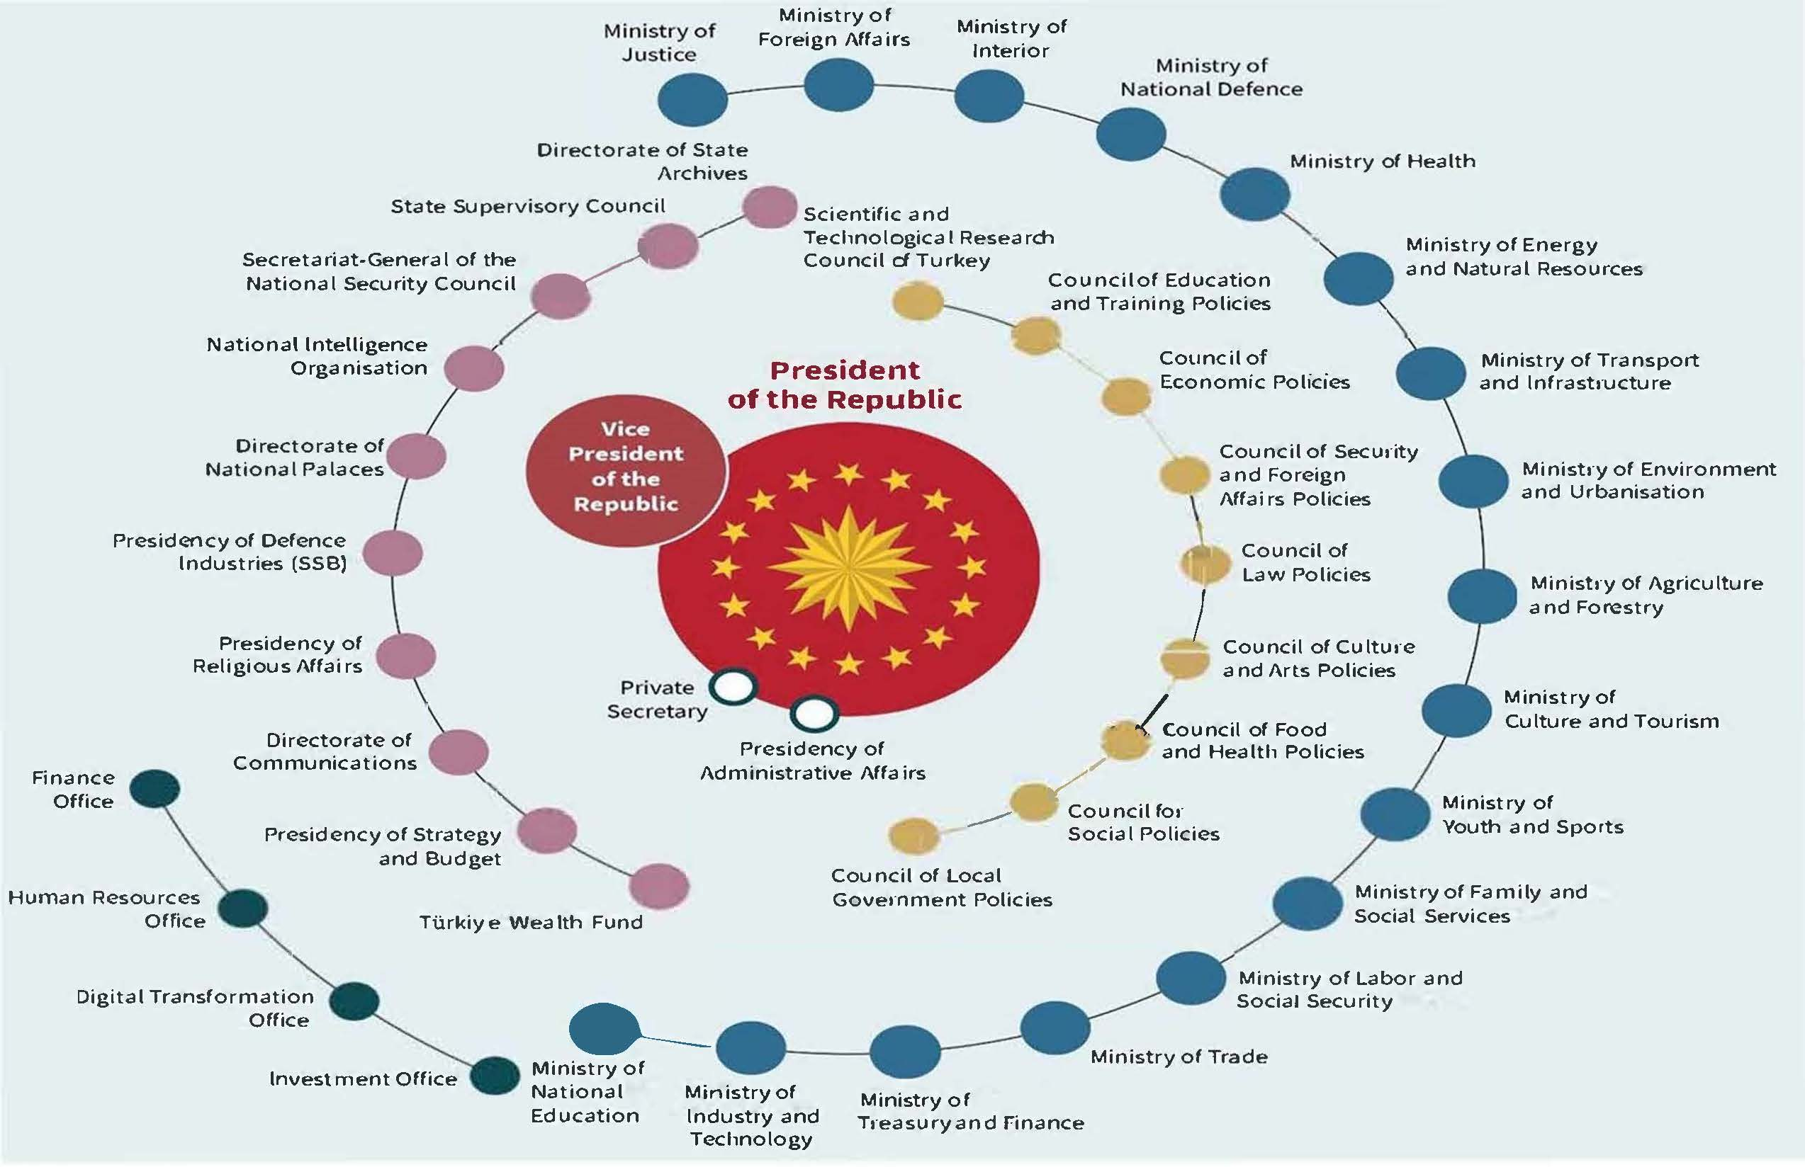

Slide 35
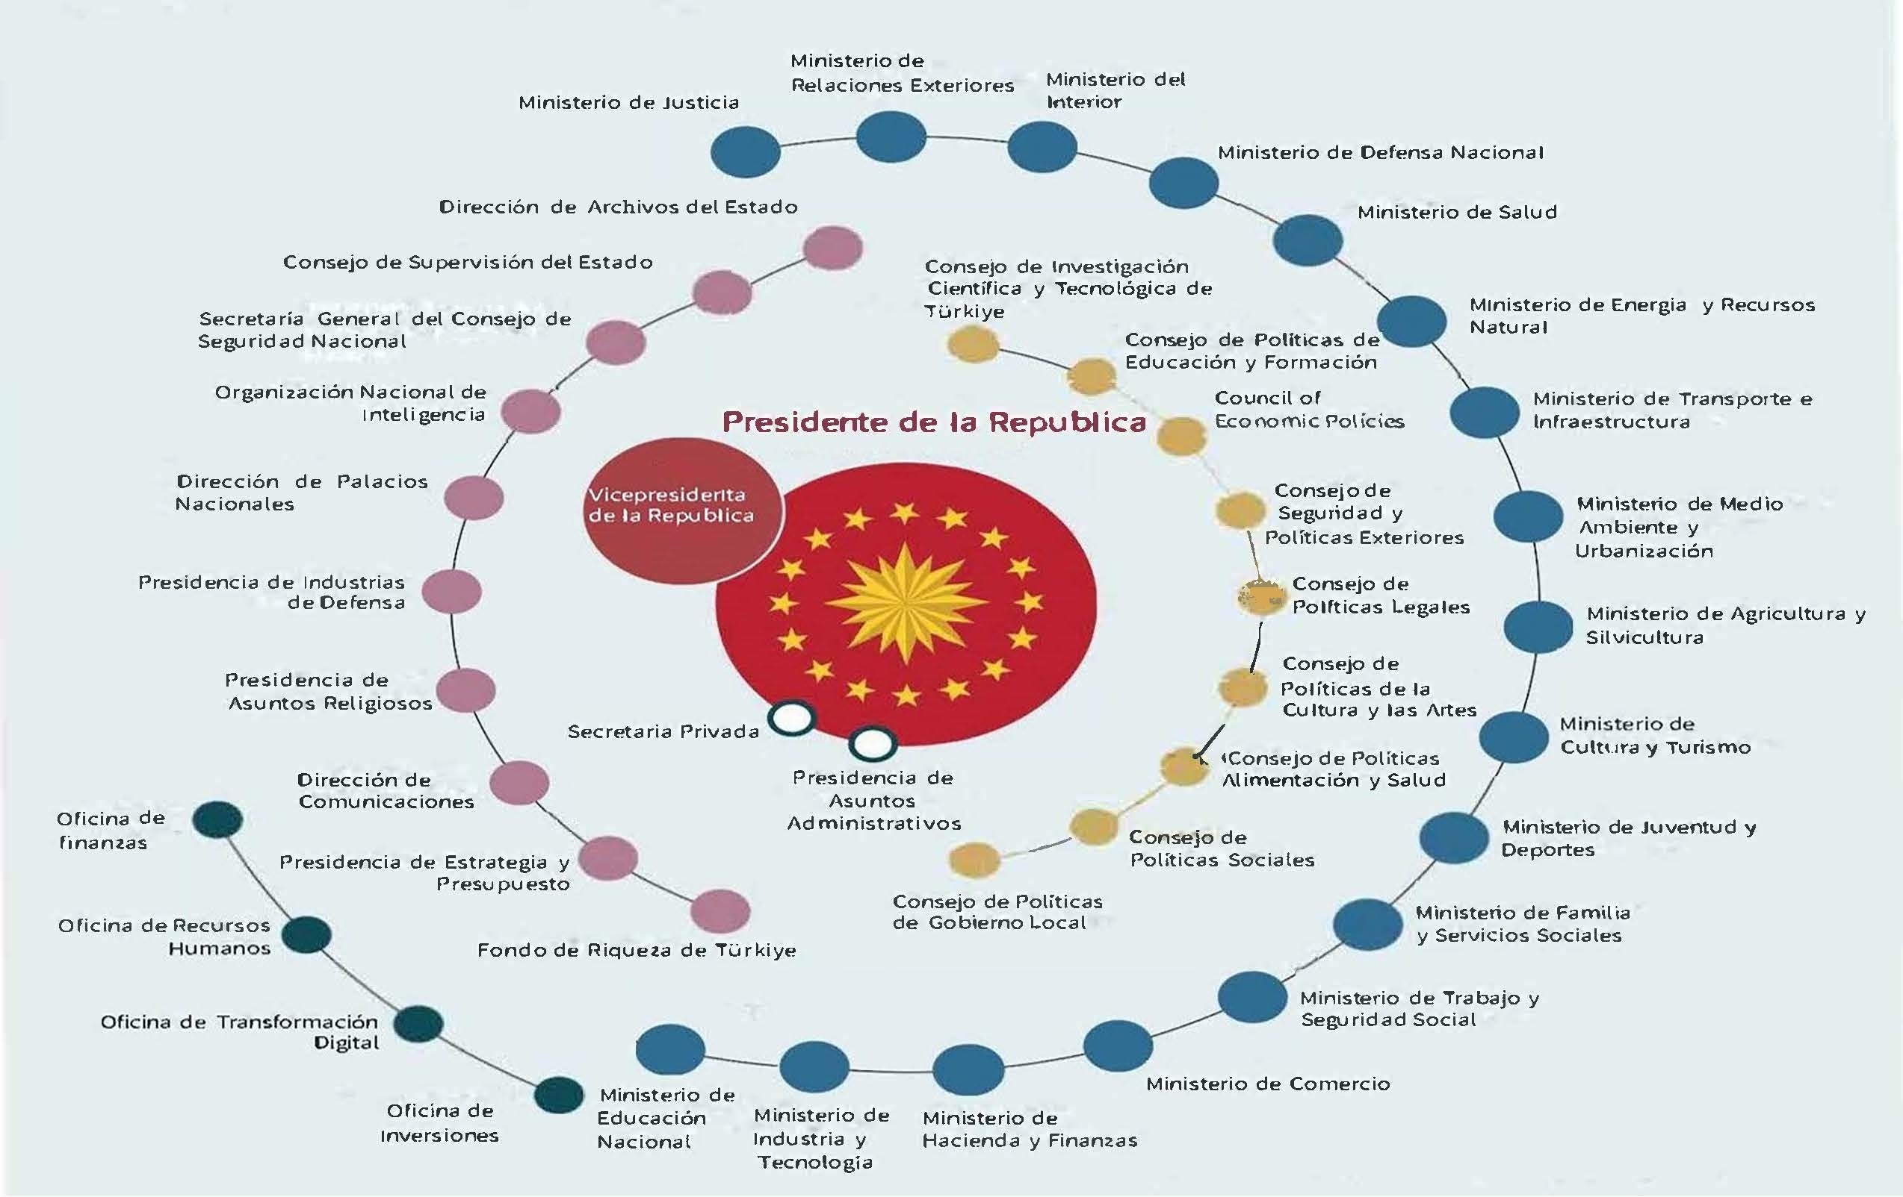

Slide 36
Thanks for your attention!

